Slide 1
CSI Sequence
Introduction and background information

Slide 2
Can you decode this message?
1 | A
2 | B
3 | C
4 | D
5 | E
6 | F
7 | G
8 | H
9 | I
10 | J
11 | K
12 | L
13 | M
14 | N
15 | O
16 | P
17 | Q
18 | R
19 | S
20 | T
21 | U
22 | V
23 | W
24 | X
25 | Y
26 | Z
23.5.12.3.15.13.5. 3.12.1.19.19.
8.1.22.5. 25.15.21.
3.18.1.3.11.5.4. 20.8.5.
3.15.4.5. ?
Notes:
Answer: Welcome class, have you cracked the code?

Slide 3
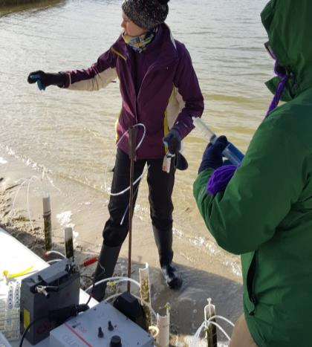
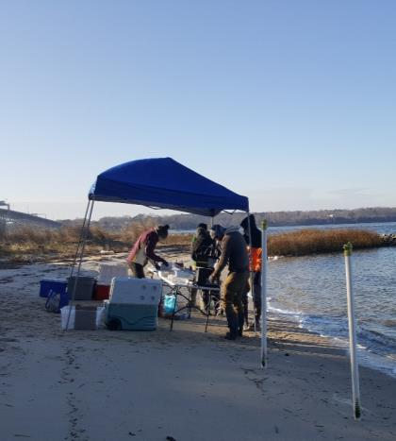
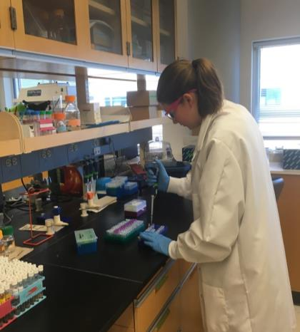
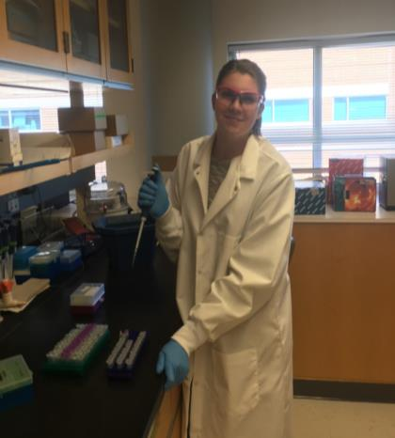
Stephanie Wilson: I am a graduate student studying nitrogen cycling in coastal ecosystems. I utilize both field and laboratory techniques to answer my research questions.
Lab Work at the Virginia Institute of Marine Science
Here I am extracting DNA from my beach samples to identify what organisms live in the water and sand.
Field Work at the Gloucester Point Beach in Virginia, USA
Here we are collecting sediment and water samples the beach!

Slide 4
DNA is like a code!
DNA encodes for genetic material
An organism’s genetic code is their blueprint
A genetic fingerprint can be used to identify an organism

Slide 5
DNA Review
Phosphate Group
Deoxyribose nucleic acid
Double stranded
Made up of four different bases: A, T, C, G
  Adenine, Thymine, Cytosine, Guanine
Two strands held together by hydrogen bonds
Nitrogenous base
Notes:
CHB comment: It would really help to show this in greater context. Here’s a good graphic that shows how this piece fits into the larger structure: https://www.compoundchem.com/2015/03/24/dna/. And, it’s Creative Commons.

Slide 6
https://www.compoundchem.com/2015/03/24/dna/

Slide 7
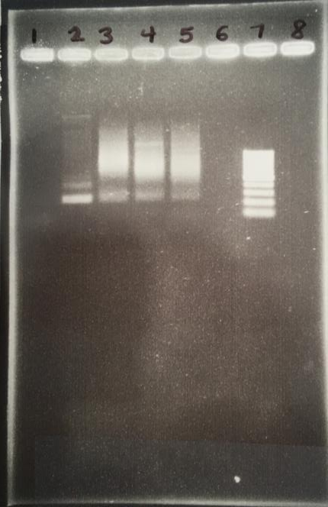
Molecular Techniques or Biotechnology
How do we identify organisms using their DNA?
We can use biotechnology techniques such as?
  Gel Electrophoresis
  DNA Sequencing
Image by Stephanie J. Wilson

Slide 8
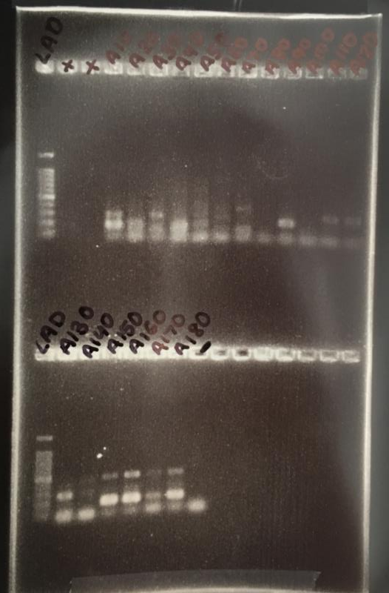
Gel Electrophoresis
A method used in identifying DNA
Separates DNA by size using an electric charge
  DNA is negatively charged
Allows for inference as to what a sample may be when compared to a standard
Video: https://www.youtube.com/watch?v=ZDZUAleWX78
Image by Stephanie J. Wilson

Slide 9
DNA Sequencing
DNA sequencing allows us to read the code of an organism
The sequence of base pairs can be read by breaking up the DNA, copying it, and introducing base pairs with fluorescent tags
  The tags can be read by a machine to determine the code and record it
Uses:
  Sample identification
  Examining genetic variation
  Looking at ancestry
Video:
  https://www.sciencelearn.org.nz/resources/2028-dna-sequencing

Slide 10
Sequence Databases
DNA sequences that have previously been identified may be available in databases
Scientists can compare new unknown sequences to previously identified ones in a database in order to attempt to identify the unknown
Databases:
  National Center for Biotechnology Information (NCBI)
  GenBank
  European Nucleotide Archive
NCBI

