Slide 1
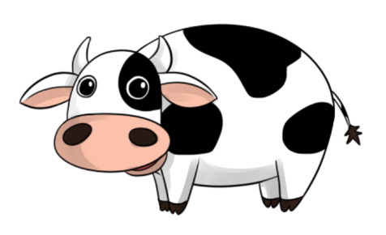
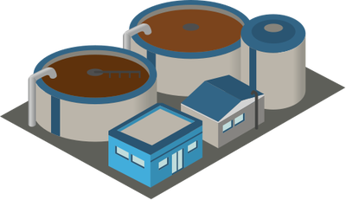
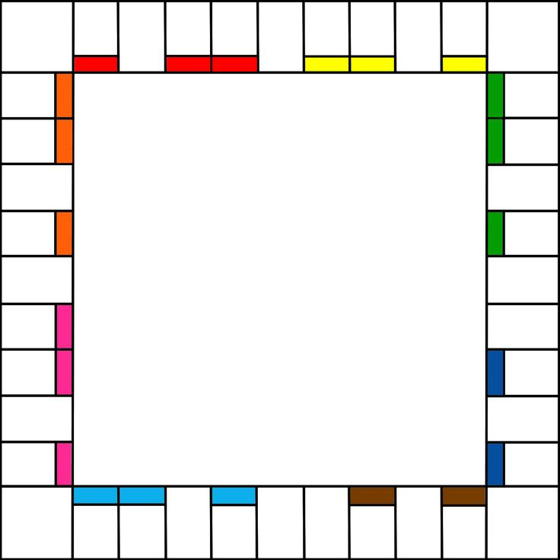

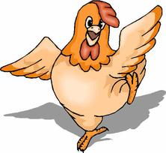
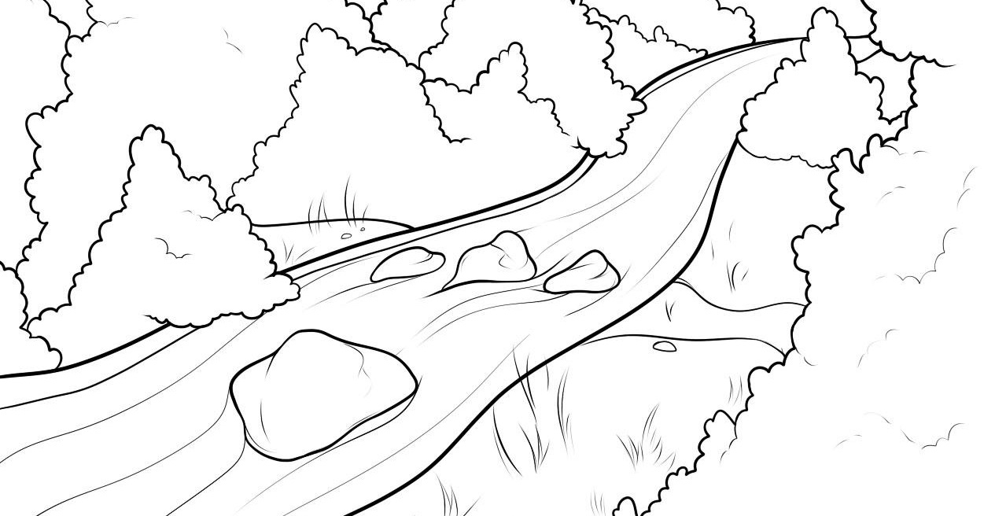


The Watershed Game:
Land Use and Water Quality
Notes:
Photo from DragoArt.com

Slide 2
The Watershed Game: Day 1

Slide 3


What is a watershed?
Dough
What do you notice about the flow direction of water over your land (playdough) molding?
Your
Molding
Notes:
Mold your playdough into any land like shape you like. Get Creative! ☺
As water is poured over mold, the students should notice that all the water collects and flows to a common location on their piece of “land”. This is how a watershed is defined!

Slide 4
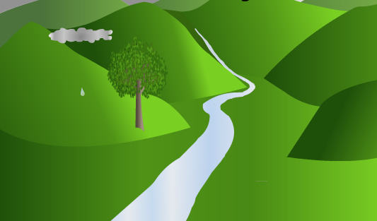
What is a watershed?
(http://www.cacaponinstitute.org/Watershed/What_Watershed.html)
Watershed Boundary (Catchment Area): an area of the earth’s surface in which all the water that is caught in this area drains to the same point
Notes:
(http://www.cacaponinstitute.org/Watershed/What_Watershed.html)

Slide 5
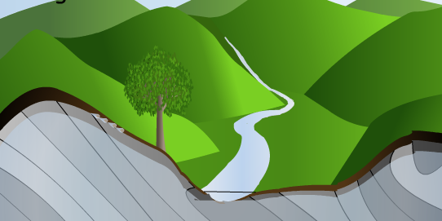
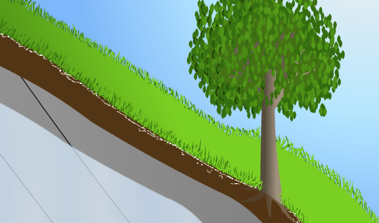
Watershed Runoff and Infiltration
As water flows from land to nearby river or stream…..
It will carry “stuff” from the land
(http://www.cacaponinstitute.org/Watershed/What_Watershed.html)
Some of that water and “stuff” may infiltrate soils and enter into groundwater
(http://www.cacaponinstitute.org/Watershed/What_Watershed.html)

Slide 6
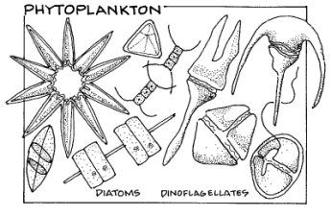


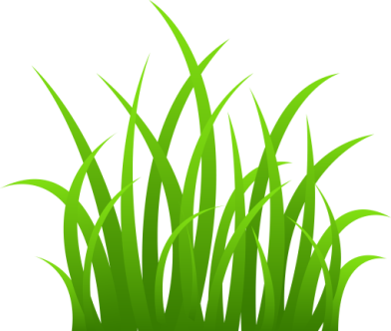
Ecosystem Response
How might what is running off of the land impact what is living in the water?
(http://www.cacaponinstitute.org/Watershed/What_Watershed.html)
What may be in the water?

Slide 7
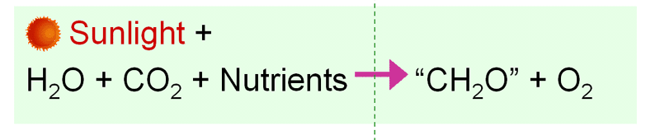
Ecosystem Response
Tiny Marine Plants
Photosynthesize

Slide 8

Estuarine Response
Nutrients

Slide 9
The Influence of Land Use/ Land Cover
What are some common land use types within watersheds?
How might these different land use types influence nutrient input?
Land Use Type | Effect on Nutrient Input
Natural Vegetation
Agriculture
Urban/Developed

Slide 10
End

Slide 11
The Watershed Game: Day 2

Slide 12
0
4
8
12
16
20
24
28
Nutrient Concentrations

Slide 13

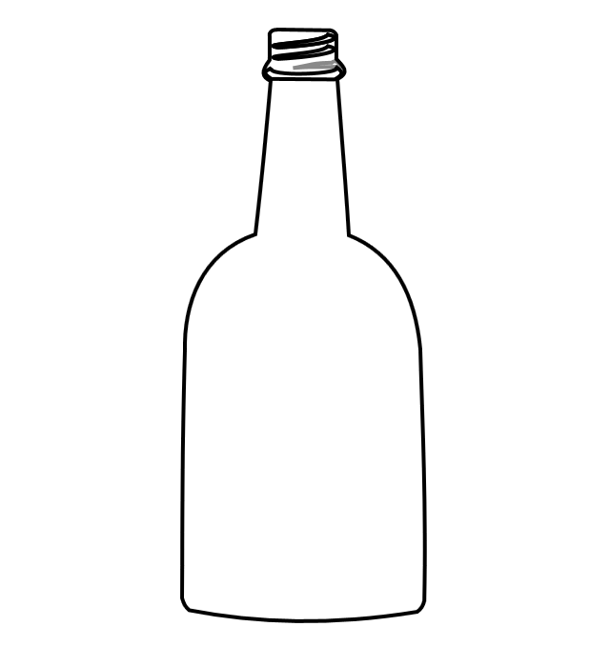
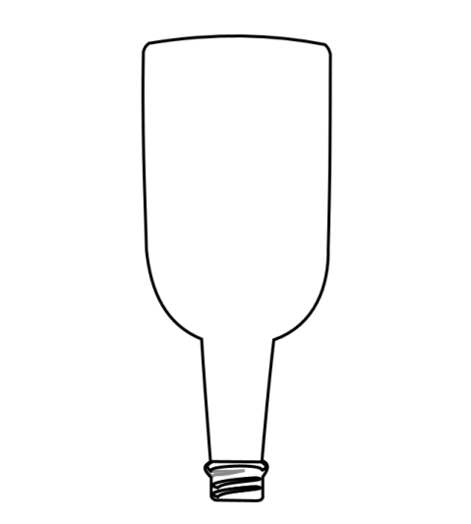

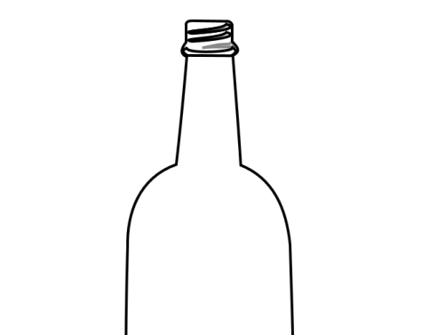
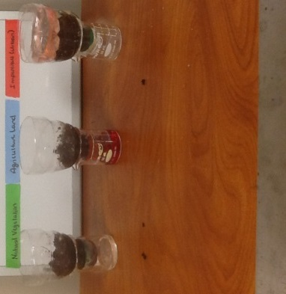
Atmospheric Nitrogen
Natural Vegetation
Agricultural Land
Impervious Surfaces
Beaker 1
Beaker 2
Beaker 3

