Slide 1
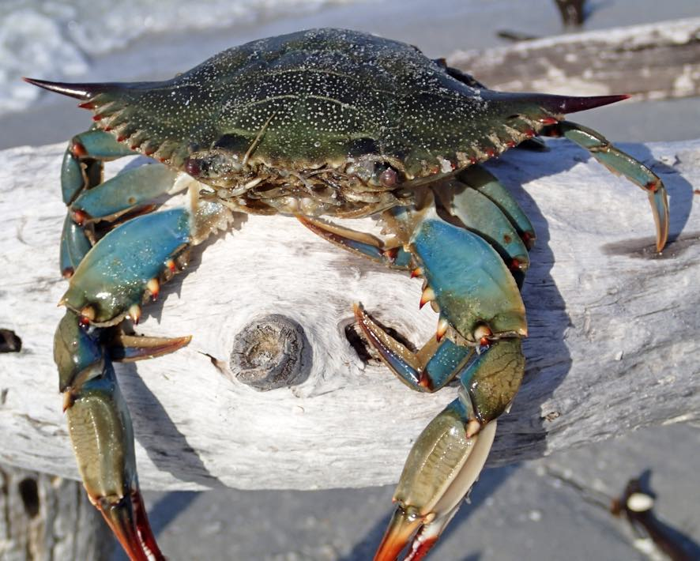
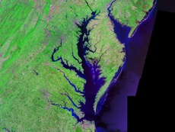
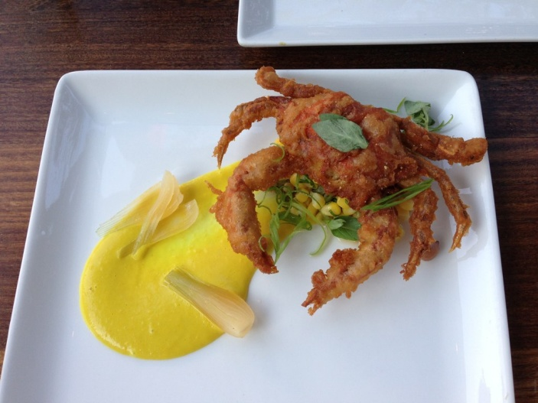
Counting Blue Crabs in the Chesapeake Bay

Slide 2
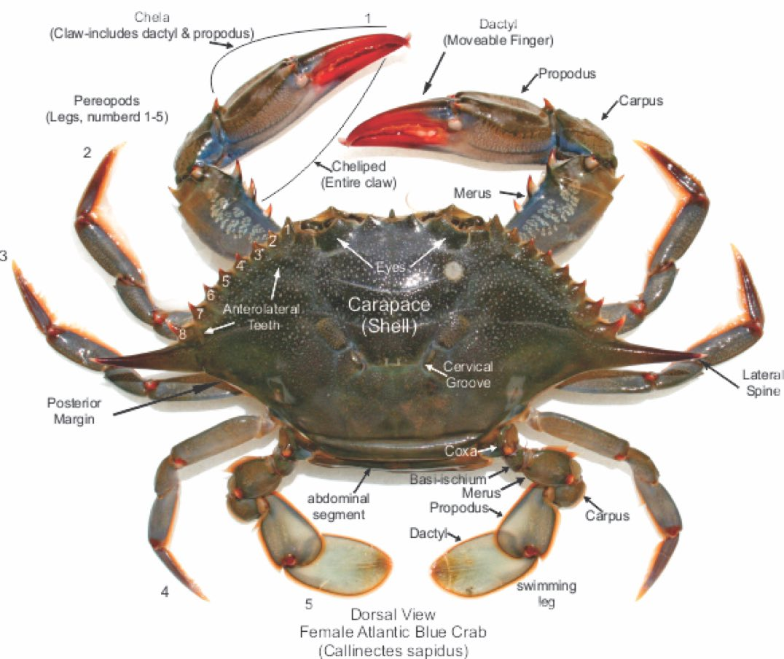
Blue Crab Anatomy
Notes:
Blue Crab Diagram Source:
Dana Point Fish Company
http://www.danapointfishcompany.com/female-atlantic-blue-crab-anatomy-callinectes-sapidus/

Slide 3
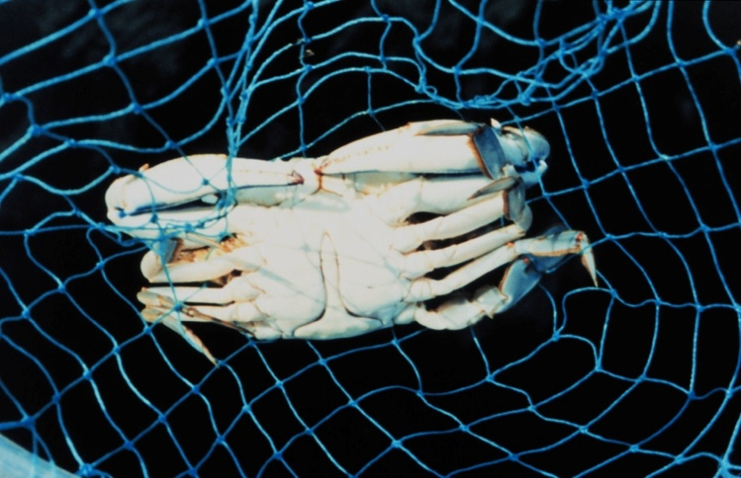
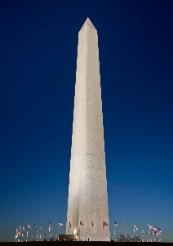
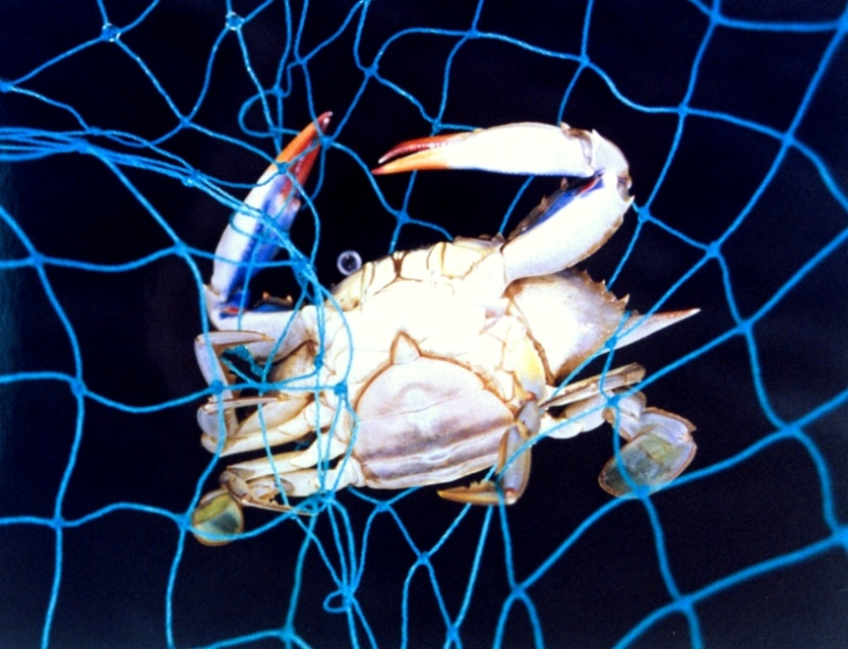
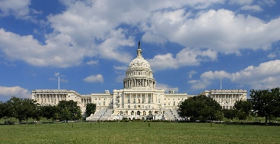
Blue Crab Identification
“Washington Monument”
Mature Male
“Capitol Building”
Mature Female
Notes:
-- Photo Credits –
Male Blue Crab:
NOAA Photo Library, line0806
Photographer: Mary Hollinger, NODC Biologist, NOAA
Date: July 25th, 1999
Link: https://www.flickr.com/photos/noaaphotolib/5114130763/
Female Blue Crab
NOAA Photo Library, line2243
Photographer: Mary Hollinger, NODC Biologist, NOAA
Date: June 17th, 2001
Link: https://www.flickr.com/photos/noaaphotolib/5114129843/
Washington Monument
Photo by David Iliff.
License: CC-BY-SA 3.0
Link: https://en.wikipedia.org/wiki/Washington_Monument#/media/File:Washington_Monument_Dusk_Jan_2006.jpg
Capitol Building
Photo by Martin Falbisoner.
License: CC BY-SA 3.0
Link: https://en.wikipedia.org/wiki/United_States_Capitol#/media/File:US_Capitol_west_side.JPG

Slide 4
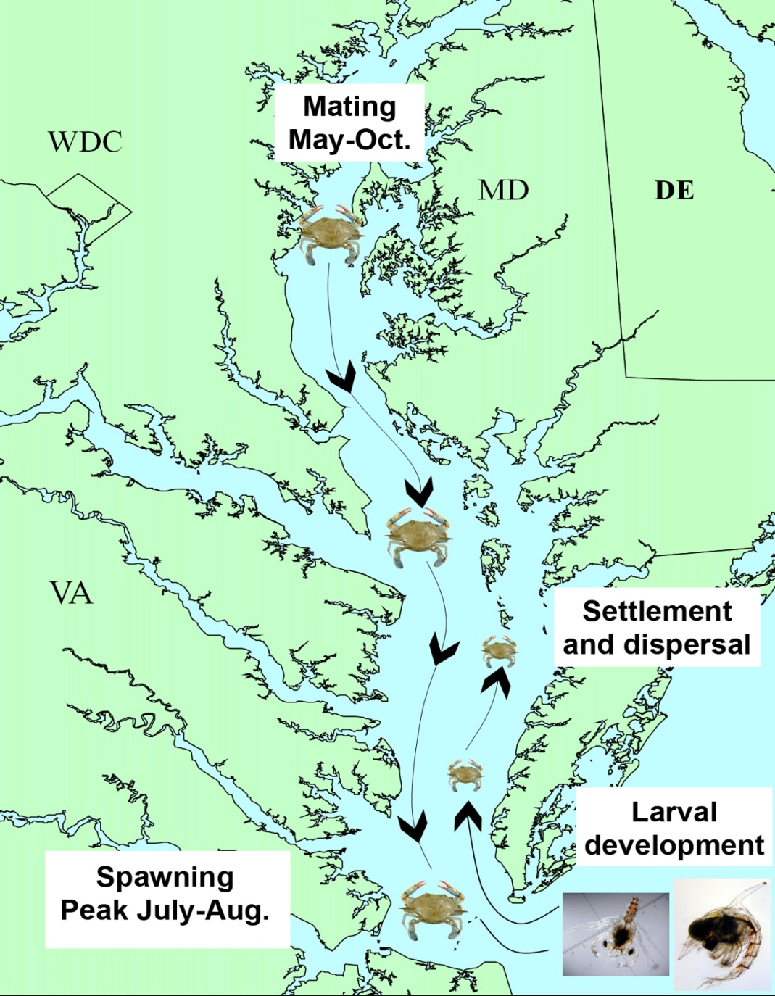
Blue Crab Life Cycle
As the juvenile crabs grow larger, they repeatedly shed their exoskeleton, called “molting”:
Megalopae – another larval form that reenters the Bay and settles to the bottom in “nursery” habitats, like seagrass beds:
Zooea – larvae that spend several months drifting with the currents at sea
Notes:
Life Cycle Diagram:
Smithsonian Environmental Research Center (SERC)
Link: http://ecosystems.serc.si.edu/top-predator/
Seagrass: Paul Richardson (VIMS Scientist), May 2016
Molting Blue Crab – Smithsonian Environmental Research Center (http://www.serc.si.edu/education/resources/bluecrab/images/Mo_2_jpg.jpg)

Slide 5
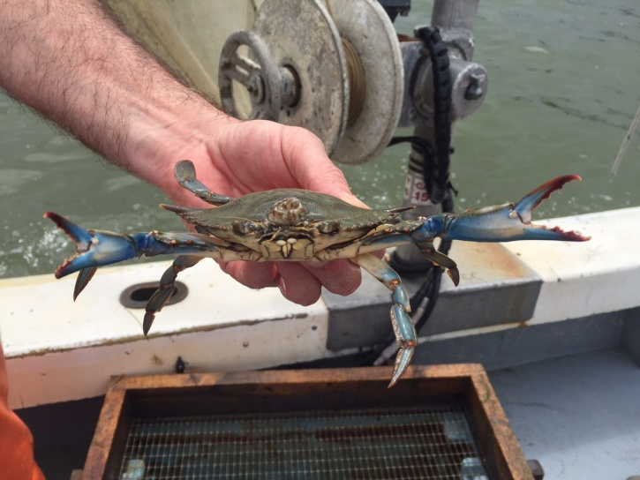
Blue Crabs in the Bay
Notes:
Bay Food Web Diagram:
http://www.bayjournal.com/article/new_fisheries_plans_would_put_emphasis_on_ecosystems
Deadrise:
http://ideastations.org/radio/news/blue-crab-harvest-be-tied-gender
Harvester:
Brad Nettles, Post and Courier
http://www.postandcourier.com/article/20140627/PC16/140629426

Slide 6
Videos & Activity

